Slide 1
【WebSphere Developer for zSeries】
Introduction

Slide 2
Overview
WebSphere(R) Developer for zSeries(R) consists of a common workbench and integrated set of tools that support end-to-end development of on demand applications and help make traditional mainframe development, Web development, and integrated mixed workload or composite development faster and more efficient. WebSphere Developer supports a broad range of developers with added flexibility and the ability to integrate with existing applications.
It accelerates the development of:
Dynamic Web applications including Java(TM) and Java 2 Enterprise Edition (J2EE).
Traditional COBOL and PL/I applications.
High level Enterprise Generation Language (EGL) applications.
Web services to integrate these applications together.

Slide 3
Features and Benefits
Deploys your applications to multiple run times including WebSphere, CICS(R), IMS(TM), Batch, and DB2(R) via Stored Procedures.
Leverages existing skills to write Web or COBOL applications by using the high level Enterprise Generation Language.
Improves the productivity for developers to create, maintain, debug and deploy traditional transactional and batch applications to the z/OS(R) platform, while providing additional tools for assisting them in their Web integration efforts.
Promotes the reuse and transformation of existing applications to help reduce costs and shorten the development cycle.
Supports SOA and Web service creation, deployable to WebSphere, CICS, and IMS environments, leveraging Enterprise COBOL and Enterprise PL/I.
Helps developers create dynamic Web applications including support for J2EE, XML, and Web services technologies.
Allows developers to rapidly create well structured on demand systems that integrate WebSphere software and traditional transactional environments, including CICS, IMS, and Batch systems.
Leverages visual construction of an open struts-based model-view-controller (MVC) model to help make application development intuitive and easy.
Provides visual development in Java Server Faces (JSF) UI oriented paradigm, including support for Java and business-oriented Enterprise Generation Language (EGL).
Facilitates the need for heterogeneous skill sets in IT organizations by supporting Java, COBOL and PL/I.
Helps transform and enable developers by facilitating skill and knowledge transfer in mission critical technologies.
Supports team member collaboration across the process of development, testing, and deployment of multi-tiered, mixed workload applications.

Slide 4
Successful Projects
[Bank of Tokyo Mitubishi UFJ Data Integration] Project
  The BTMU project started on Oct 2007. The 1st phase was offsite development. And 328 Cobol programs were developed via WD/z.
  The 2nd phase was host test in which all these programs were tested on OS/390. Due to the successful 1st phase, only 7 bugs were discovered.
[Japan Research Institute] Project
  The JRI project started on Jan, 2008. The 1st phase was offsite development. And 25 Cobol programs, 57 PL/1 programs were developed via WD/z.
  The 2nd phase was host test in which all these programs were tested on OS/390. Due to the successful 1st phase, only 12 bugs were discovered.

Slide 5
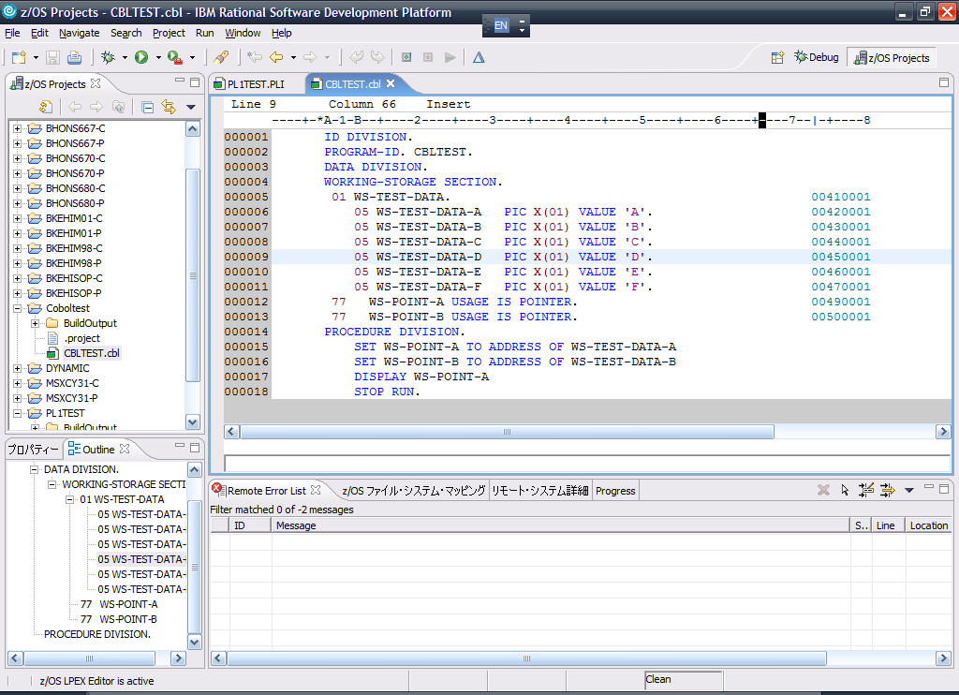
Development Layout

Slide 6
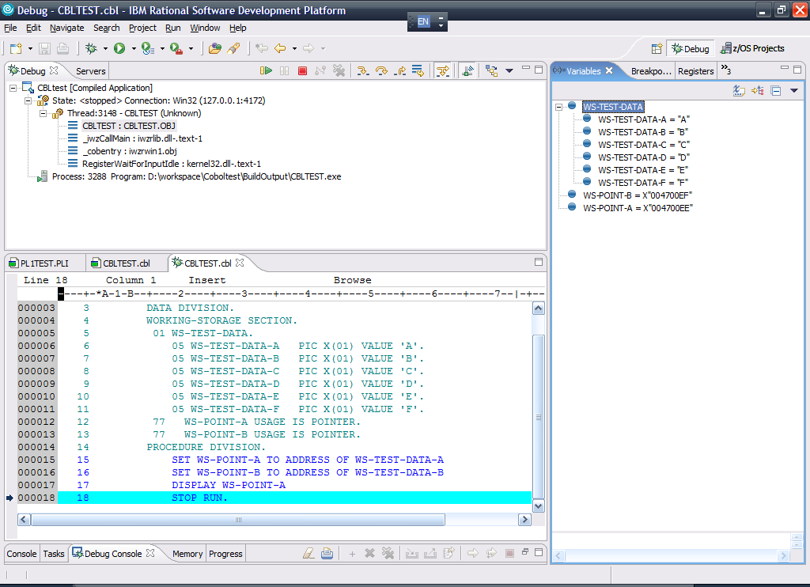
Debug layout

